Slide 1
Digital Circuit Diagram Recognition
James Brown, Eric Doi,
Emily Fujimoto, Marty Field
Christine Alvarado

Slide 2
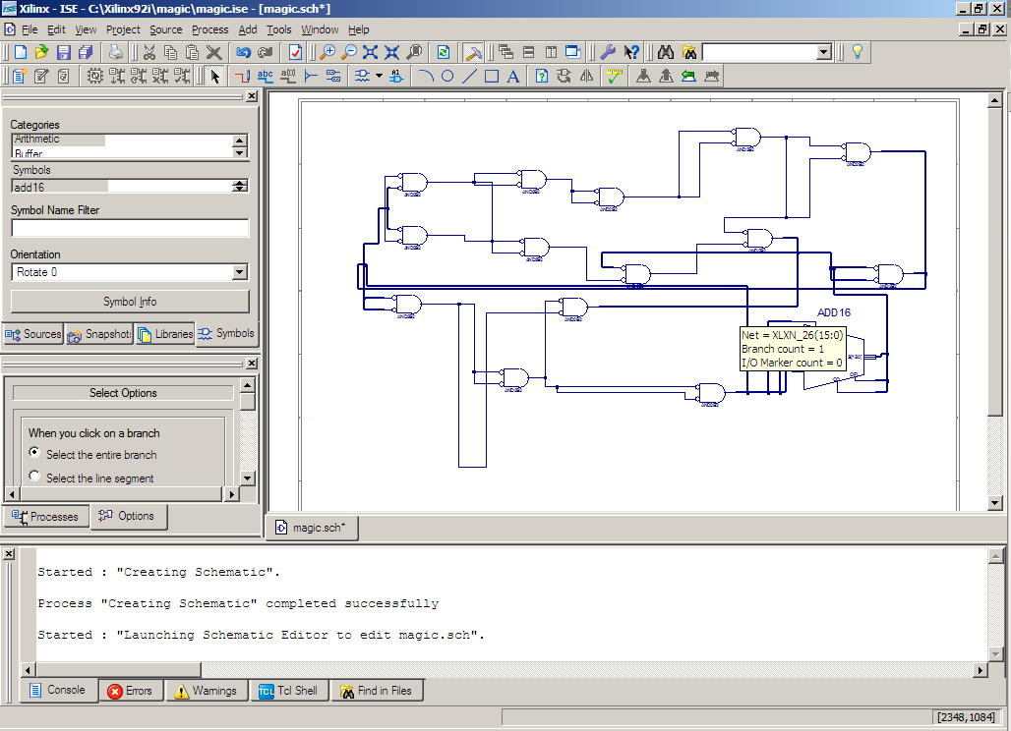
Introduction/Motivation

Slide 3
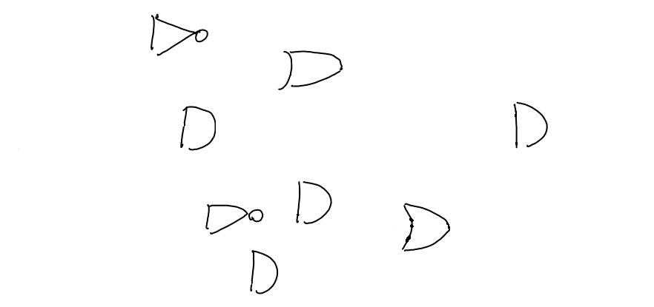
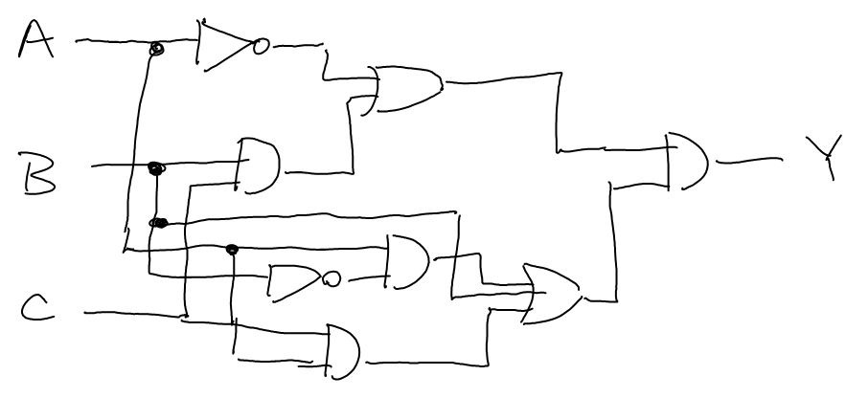
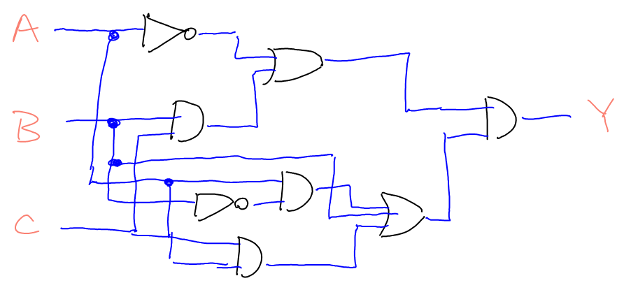
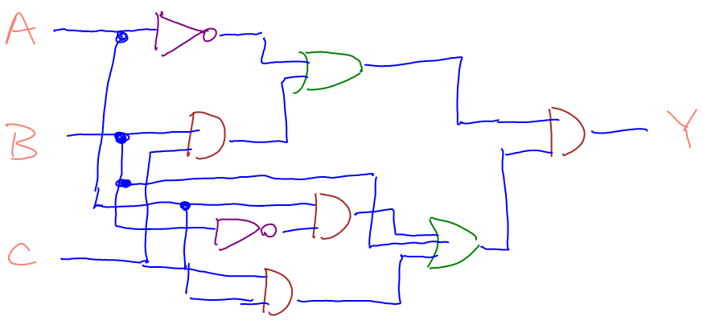
Recognition Overview
Notes:
Here, we have an unlabeled sketch.
First, we apply labels of “wire”, “gate”, or “label” to each stroke in the sketch.

Slide 4



The Importance of Context
A wire?
A gate?
What is this?
A label?
Notes:
A conditional random field provides a good way to account for context.

Slide 5
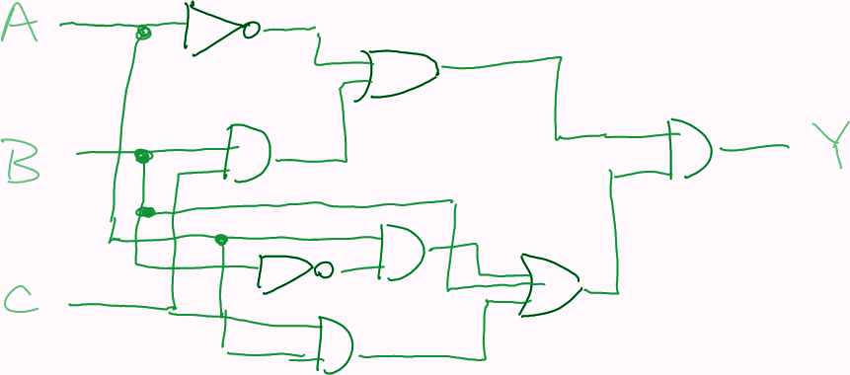
Conditional Random Field (CRF)
Determines P(y|x)
  y is a vector of labels, each of which is applied to a stroke
    Each component of y is either wire or gate
  x is the set of all observations
e.g.
P( [All OR gates!] | x ) ≈ 0
Slide modified from Jason Fennell, Max Pflueger, Devin Smith, Aaron Wolin. 2007

Slide 6
Symbol Recognition
Once we’ve isolated the gates, we need to determine what they are (e.g., “AND”, “OR”, “NOT”)
Different approaches:
  Feature-based
  Image-based

Slide 7




Symbol Recognition: Congealer
Congealing Example
Notes:
Talk about pre-alignment and affine transform search

Slide 8
Symbol Recognition:
Congealer Results
 | and | bubble | nand | nor | not | or | xor | Recognition
and | 10116 | 1015 | 109 | 32 | 1225 | 909 | 0 | 75.46%
bubble | 281 | 256 | 0 | 0 | 205 | 0 | 0 | 34.50%
nand | 493 | 0 | 4236 | 310 | 4732 | 61 | 0 | 43.08%
nor | 377 | 0 | 727 | 5244 | 2561 | 741 | 0 | 54.34%
not | 0 | 0 | 144 | 59 | 12230 | 23 | 0 | 98.19%
or | 1178 | 308 | 0 | 691 | 1277 | 6852 | 1210 | 59.50%
xor | 381 | 622 | 81 | 211 | 938 | 816 | 7195 | 70.24%
Precision | 78.87% | 11.63% | 79.97% | 80.10% | 52.79% | 72.88% | 85.60%
 |  |  |  |  |  | Total Accuracy |  | 67.99%
Notes:
Highlights: 98% on NOT gates, with over 12000 examples being classified
Lowlights: Only 34.5% on bubbles
Talk about why!

Slide 9

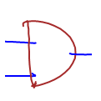

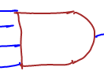
Symbol Recognition:
Congealer Problems
Highly variable sketching styles:
Computationally intensive:
  Recognition takes between two and ten seconds for each gate.
  Training takes upwards of 40 CPU-hours
Notes:
This is a selection of AND gates taken from our data.
Note: easily parallelizable to 8-threads; already coded to support threading

Slide 10


Symbol Recognition:
As Gestures
Symbol
Gesture
one or many strokes
order and direction
  unimportant to meaning
one stroke only
direction important to meaning
Notes:
Introduction to Symbols vs. Gestures:
Symbol: final shape important
Gesture: act of drawing important
The reason we want to do this is considering gates as gestures encodes information about how the user drew the gate.

Slide 11
Sketching Style Study
It is easy to collect data by asking users to draw a specific shape.
Is it safe to use this data to train a recognizer?
  What if users draw differently if they have to think about what they’re drawing?
Gestures place emphasis on being drawn the same every time.
Notes:
Motivation for the study

Slide 12
Sketching Style Study
Use gesture recognizers to determine similarity of shapes between drawing tasks.
  Copy task
    Isolated gates
    Entire circuits
  Synthesis task
    Given logical expression, create a circuit
High recognition accuracy comes from consistent drawing styles.
Notes:
Layout of the study:
-train on one activity, test on another
-compare to training and testing on same
-all pairwise combinations
The goal:
-if we can get high recognition accuracy across tasks, then the gates were drawn consistently.

Slide 13
The $1 Gesture Recognizer
0
1
2
3b
3a
Notes:
How do you recognize a gesture?
1991 paper by Dean Rubine: 13 features, complex matrix operations.
2007 paper by Wobbrock, Wilson, and Li presents an extremely effective solution in about 100 lines of code. Outperforms Rubine. Easy to add training examples incrementally.
Step 1: resample
Step 2: rotate, center, scale
Step 3: (for classification) rotation search
Step 3b: (for classification) point-to-point distance

Slide 14
Adding my thoughts to create $1.02
Resample: points per shape
Skip initial rotation
Ignore point order

Slide 15
Sketching Style Survey Results
Notes:
The training set used did not have a significant impact on the recognition rates.

Slide 16
The Effect of User-Specific Training Examples
Notes:
# of user specific training examples did have a significant effect.
Furthermore, evidence indicates that user-specific training examples should replace global training examples as they can be collected.

Slide 17
Future Work
Examine alternate feature-sets for the CRF
Integrate multiple recognizers

